Slide 1
Apple's journey in India
First iPhone to launch in India and other biggest milestones over the years.
The first store, called Apple BKC, is in the populous city of Mumbai. Apple on Thursday will open another store in the capital of Delhi.
Apple CEO Tim Cook has long held a bullish view on India and now the company is ramping up sales and manufacturing of its flagship iPhone in the country.

Slide 2

It took Apple 15 years to open a company-run retail store in the world's second-largest smartphone market, where it first began selling the iPhone. From not launching its first-ever iPhone in India to reportedly assembling nearly 7% of iPhones sold globally in India, India has come a long way in terms of its significance for the Cupertino giant. Apple's revenue in India increased by 15% in the most recent quarter. As Apple opens its first stores, here is a timeline of its journey in the world’s second-biggest smartphone market.

Slide 3
According to analysts, Apple's plan for entering China, which is now one of the company's biggest markets, was similar to how it is attempting to increase sales and manufacturing of iPhones in India.
With a specialised solar energy system and 0% dependency on fossil fuels for store operations, Apple says that its Mumbai site is "one of the most energy-efficient" in the entire globe. According to Apple, the BKC uses only renewable energy.
In February, Cook stated that he was "bullish" on the world's fifth-largest economy and that Apple is investing a "significant amount of energy" in the country. Cook has long seen India as a critical market for Apple's future. Cook visited India to inaugurate the shop.

Slide 4
The low-to-mid-tier priced handsets are supported by users in a price-sensitive market, however Samsung and Chinese brands like Xiaomi have recently dominated India's smartphone industry. In India, Apple holds a little portion of the market.
Neil Shah, a partner at Counterpoint Research, claims that India is, nonetheless, experiencing a "premiumization of the market." In comparison to before the pandemic, smartphones costing more than $400 now make up 10% of all devices shipped, according to Shah. According to him, revenue from this subset of smartphones makes about 35% of the entire smartphone market. As usual, Shah told CNBC via email, "Apple has got the timing right on 'peaking at the right time' with its flagship store strategy to catalyse this trend in its favour."
Particularly in Mumbai and Delhi, two of the richest cities in the nation and the locations of the new Apple stores, there is a growing middle class in India, as well as a young, "mobile first" populace eager to pay more for smartphones.

Slide 5
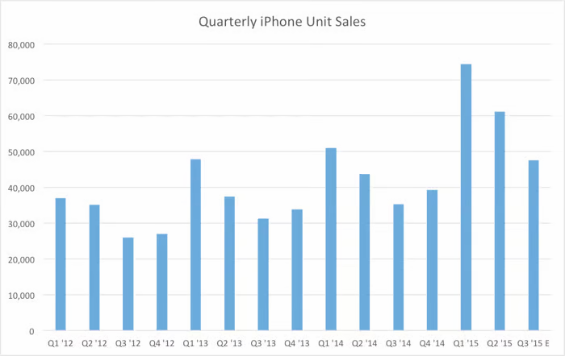
iPhone sales in focus:
According to analysts, Apple's push into India presents the company with a chance to increase revenue and iPhone sales to levels similar to those in China and other developed economies.
According to Counterpoint Research, Apple supplied roughly 6.5 million iPhones to India in 2022, compared to about 50 million units annually in both China and the United States. India "has the potential to reach that scale" in the ensuing years, according to Shah.
Shipments are the iPhones that Apple distributes to merchants; nevertheless, they do not equate to sales. However, it serves as a gauge of the demand for iPhones in a certain nation.

Slide 6
According to experts, Apple's drive into India presents a chance for the American tech giant to increase sales of the iPhone and revenue to levels similar to those in China and other developed nations.
According to Counterpoint Research, Apple distributed around 6.5 million iPhones in India in 2022 as opposed to roughly 50 million units annually in the U.S. and China. India, according to Shah, "has the potential to reach that scale" in the ensuing years.
Apple provides iPhones to merchants in the form of shipments, which are not the same as sales. A country's desire for iPhones can be determined by this, though.

Slide 7
According to a person familiar with the situation cited by Bloomberg on Monday, Apple generated $6 billion in sales from January through March, a 50% increase.
Over the following two years, according to Wedbush Securities analyst Dan Ives, that number may increase even further.
Ives said in a report posted on Tuesday that Apple is "now aggressively looking at India from both a production and retail expansion over the coming years. We believe this will be a strategic poker move for Cupertino that could ramp annual revenue to $20 billion in India by 2025."
However, it goes beyond simply selling iPhones. Users have been tied into Apple's suite of goods, including the Apple Watch and services like Apple Music, as part of the company's strategy throughout the years.

Slide 8
Manufacturing push:
The flagship iPhone 14 was initially assembled in India last year, so close to its original release, marking the first time the business has done so. Apple plans to manufacture 25% of all of its iPhones in India, according to Piyush Goyal, India's minister of business and industry, who made the announcement in January.
The government's initiative to encourage high-tech manufacturing in India is connected in part to the movement there. Apple is attempting to diversify its product manufacture away from China, though. The Covid pandemic and the rigorous steps Beijing adopted to contain the outbreak highlighted supply chain vulnerabilities in the second-largest economy in the world.

Slide 9
"As Foxconn/Apple puts more skin in the game on the iPhone production front within India, this will go hand in hand with a bigger retail presence within India, as seen this week, which mirrors the early days of the China penetration strategy going back a decade," Ives said.
"Rome was not built in a day, and neither will Apple's broader India strategy; however, we see this week as Apple diving into the deep end of the pool in India as this massive market gradually converts to the Apple ecosystem over the coming years, with iPhone market share gains front and centre."

